Slide 1
2
DERIVATIVES

Slide 2
2.4
The Product and Quotient Rules

Slide 3
The Product Rule

Slide 4
THE PRODUCT AND QUOTIENT RULES
The formulas of this section enable us to differentiate new functions formed from old functions by multiplication or division.
By analogy with the Sum and Difference Rules, one might be tempted to guess, as Leibniz did three centuries ago, that the derivative of a product is the product of the derivatives.
We can see, however, that this guess is wrong by looking at a particular example.

Slide 5
THE PRODUCT RULE
Let and . Then the Power Rule gives and . But , so .
Thus

Slide 6

The Product Rule
The following formula was discovered by Leibniz and is called the Product Rule.
In words, the Product Rule says that the derivative of a product of two functions is the first function times the derivative of the second function plus the second function times the derivative of the first function.

Slide 7
THE PRODUCT RULE PROOF
Let F(x) = f(x)g(x).
Then,

Slide 8
THE PRODUCT RULE PROOF
In order to evaluate this limit, we would like to separate the functions f and g as in the proof of the Sum Rule.
We can achieve this separation by subtracting and adding the term f(x + h)g(x) in the numerator, as follows.

Slide 9
THE PRODUCT RULE PROOF

Slide 10
THE PRODUCT RULE PROOF
Note that because g(x) is a constant with respect to the variable h.
Also, since f is differentiable at x, it is continuous at x by Theorem 2.2.4, and so .

Slide 11

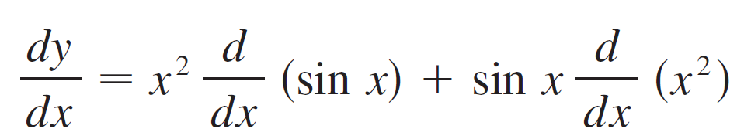

Example 1
Differentiate
SOLUTION:
Using the Product Rule, we have

Slide 12
Example 2
Differentiate the function
SOLUTION 1
Using the Product Rule, we have

Slide 13
Example 2 SOLUTION 2
If we first use the laws of exponents to rewrite f(t), then we can proceed directly without using the Product Rule. which is equivalent to the answer given in Solution 1.

Slide 14
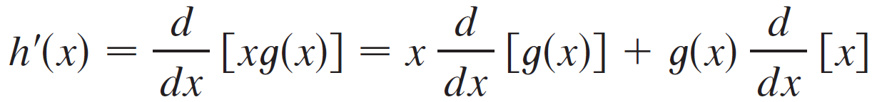

Example 3
If h(x) = xg (x) and it is known that g(3) = 5 and g′(3) = 2, find h′(3).
SOLUTION:
Applying the Product Rule, we get

Slide 15
Example 3 – Solution
cont’d
Therefore

Slide 16
The Quotient Rule

Slide 17
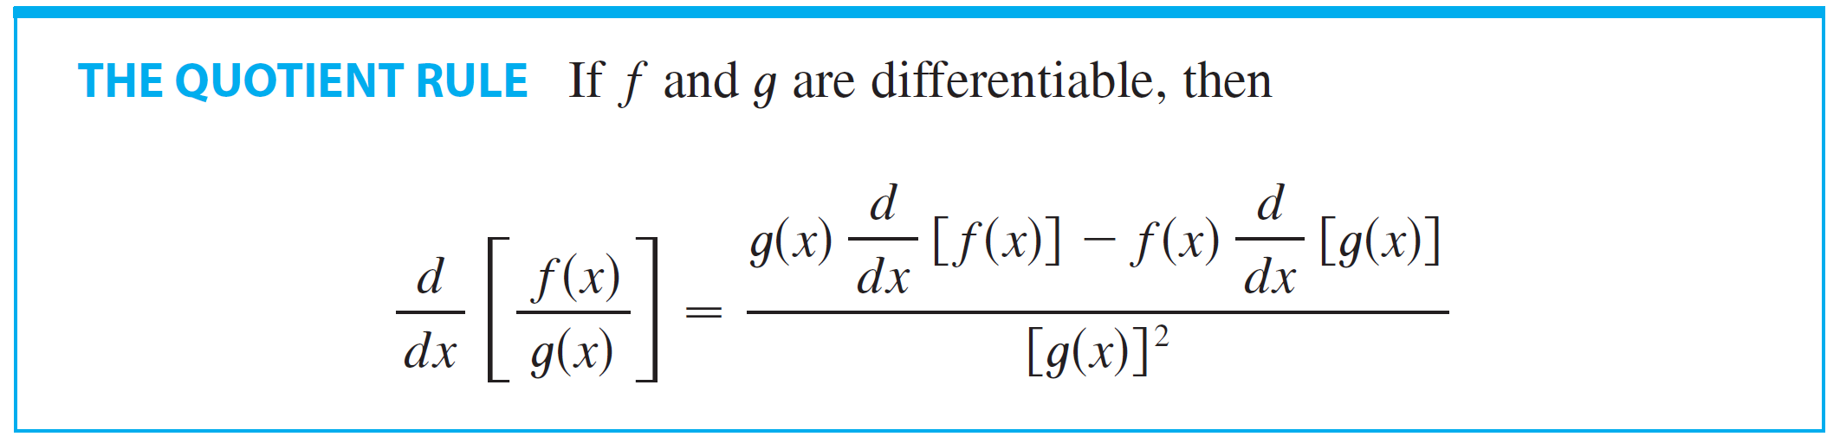
The Quotient Rule
The following rule enables us to differentiate the quotient of two differentiable functions.
In words, the Quotient Rule says that the derivative of a quotient is the denominator times the derivative of the numerator minus the numerator times the derivative of the denominator, all divided by the square of the denominator.

Slide 18
THE QUOTIENT RULE PROOF
Let F(x) = f(x)/g(x).
Then,

Slide 19
THE QUOTIENT RULE PROOF
We can separate f and g in that expression by subtracting and adding the term f(x)g(x) in the numerator:

Slide 20
THE QUOTIENT RULE PROOF
Again, g is continuous by Theorem 2.2.4
So,

Slide 21
Example 4
Let
Then,

Slide 22
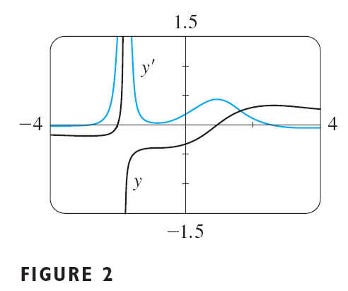
Example 4
We can use a graphing device to check that the answer to Example 4 is plausible. Figure 2 shows the graphs of the function of Example 4 and its derivative. Notice that when grows rapidly (near – 2), y’ is large. And when grows slowly, y’ is near 0.

Slide 23


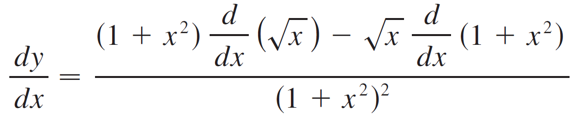
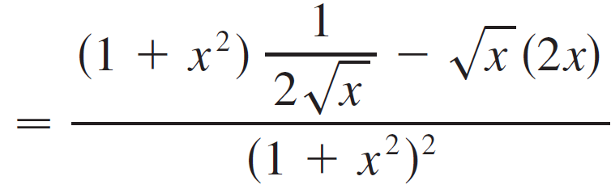
Example 5
Find an equation of the tangent line to the curve at
the point .
SOLUTION:
According to the Quotient Rule, we have

Slide 24
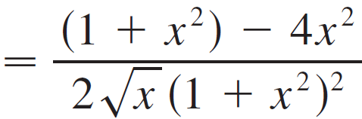
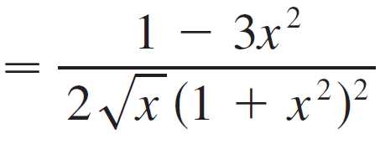

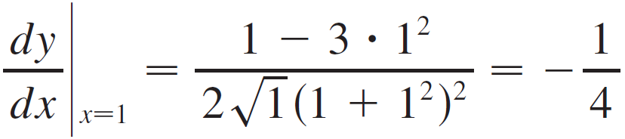
Example 5 – Solution
cont’d
So the slope of the tangent line at is

Slide 25



Example 5 – Solution
cont’d
We use the point-slope form to write an equation of the tangent line at :
or
The slope of the normal line at (1, ½) is the negative reciprocal of -¼, namely 4.
Thus, an equation of the normal line is:
Figure 3

Slide 26
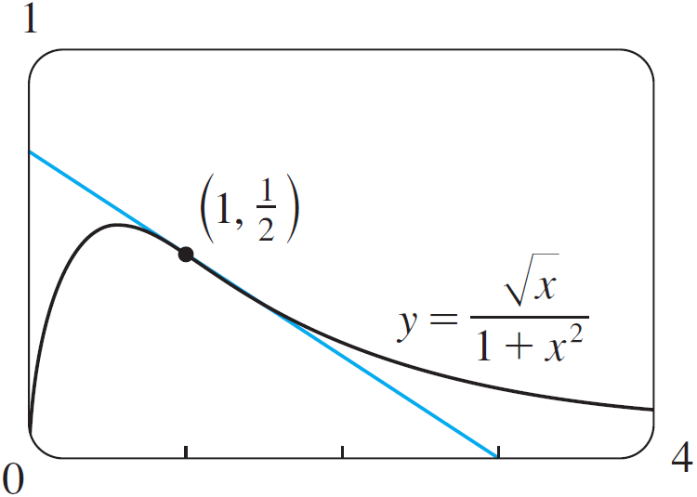
Example 5 – Solution
The curve and its tangent line are graphed in Figure 3.

Slide 27
NOTE
Don’t use the Quotient Rule every time you see a quotient.
Sometimes it’s easier to rewrite a quotient first to put it in a form that is simpler for the purpose of differentiation.
For instance, although it is possible to differentiate the function

Slide 28
NOTE
Using the Quotient Rule, it is much easier to perform the division first and write the function as before differentiating.

Slide 29
Trigonometric Functions

Slide 30
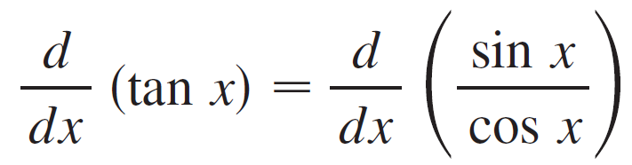
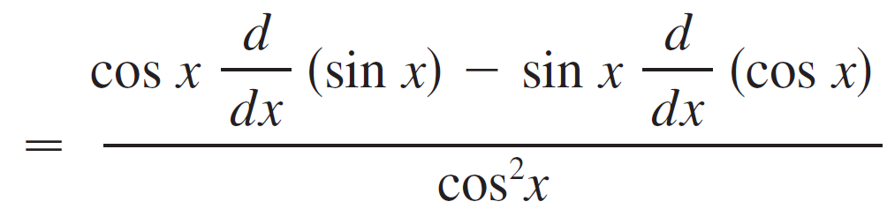
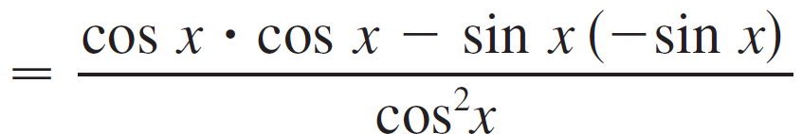
Trigonometric Functions
Knowing the derivatives of the sine and cosine functions, we can use the Quotient Rule to find the derivative of the tangent function:

Slide 31
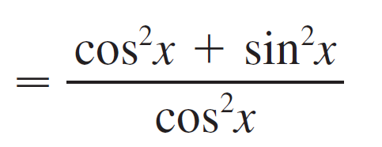
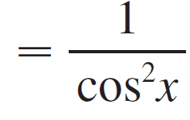

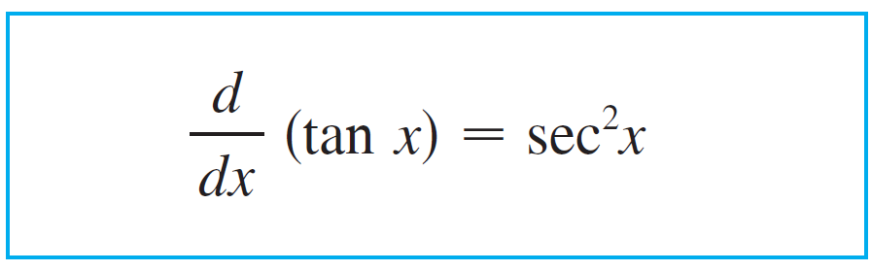
Trigonometric Functions

Slide 32
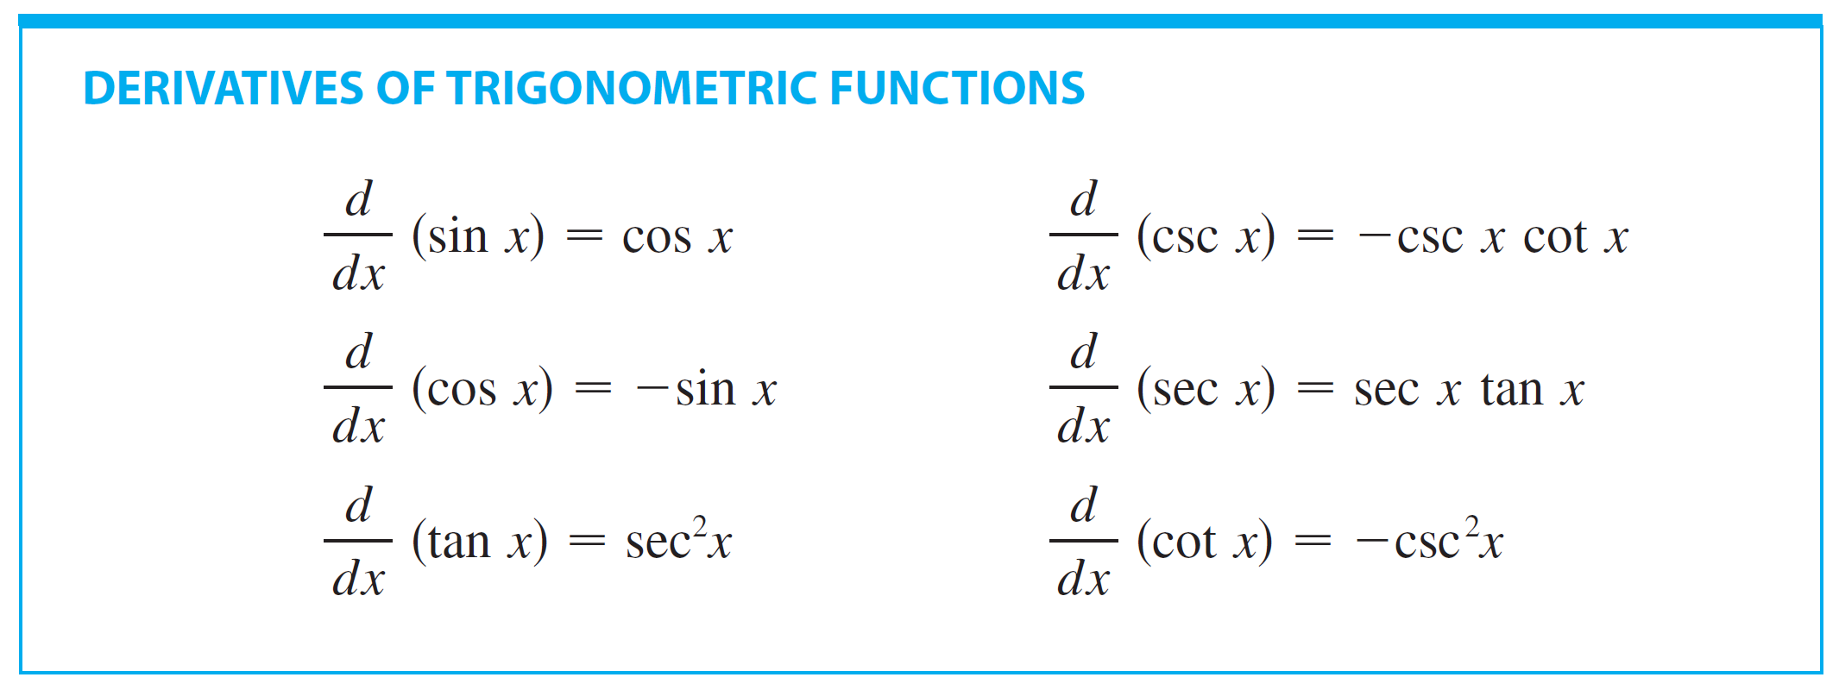
Trigonometric Functions
The derivatives of the remaining trigonometric functions, csc, sec, and cot, can also be found easily using the Quotient Rule (see Exercises 37–39).
We collect all the differentiation formulas for trigonometric functions in the following table.
Remember that they are valid only when x is measured in radians.

Slide 33
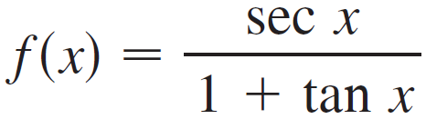
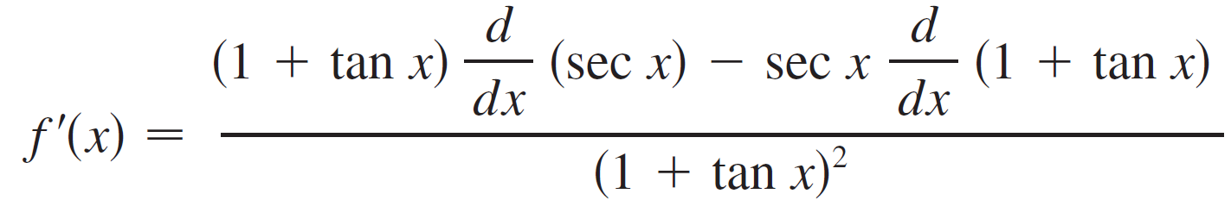
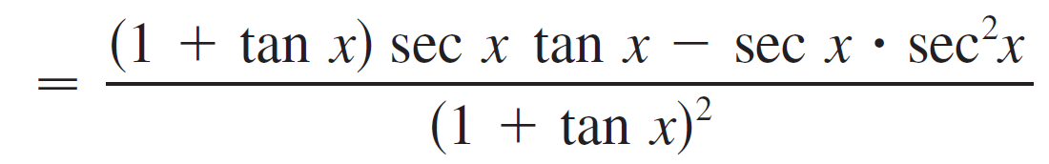
Example 6
Differentiate . For what values of x does the
graph of f have a horizontal tangent?
SOLUTION:
The Quotient Rule gives

Slide 34
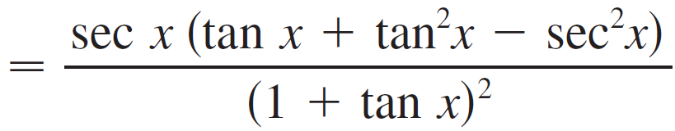
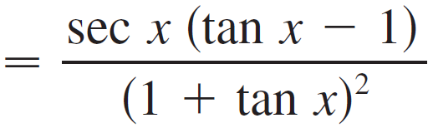

Example 6 – Solution
cont’d
In simplifying the answer we have used the identity

Slide 35


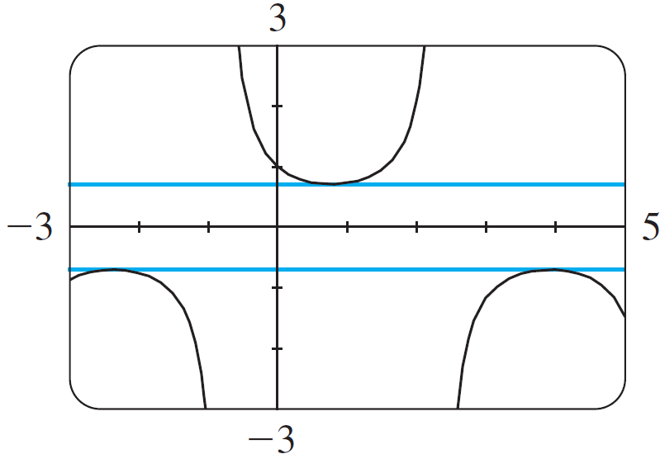
Example 6 – Solution
cont’d
Since sec x is never 0, we see that when tan x = 1, and this occurs when where n is an integer (see Figure 4).
The horizontal tangents in Example 6
Figure 4

